Slide 1
MICROSOFT FILM PRODUCTION
WACHUKA KINYANJUI

Slide 2
DIRECTORY:
Introduction
Principal target
Steering prompts
Outcome

Slide 3
INTRODUCTION
Microsoft should venture into the film production
This could diversify their portfolio and tap into the entertainment industry’s lucrative market.
Due to the company’s vast resources and expertise in technology, Microsoft could innovate film-making processes and enhance distribution channels.
This would align with its content creation efforts hence enhancing its brand and revenue streams

Slide 4
PRINCIPAL TARGETS
Proper analysis of the data under review which should provide perspective on whether Microsoft should venture in film production

Slide 5
STEERING PROMPTS
Below are the guiding questions by which data insights have been drawn:
Movie title to use(Should the original title be retained or is there a need to rebrand the film for market viability?)
Genre to use to create unique storytelling experiences whilst catering to the various needs of the consumers(Which genres are currently on demand?)
Language of production(Which languages have the best market reception? What geographical location is being catered for?)

Slide 6
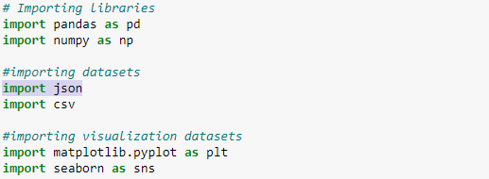
PRELIMINARY EDA
My insights are from data drawn from Box Office Mojo, IMDB, Rotten Tomatoes, TheMovieDB and The Numbers collected over a 12 year period.
The analysis was done by importing the necessary packages then loading the dataset under review .

Slide 7
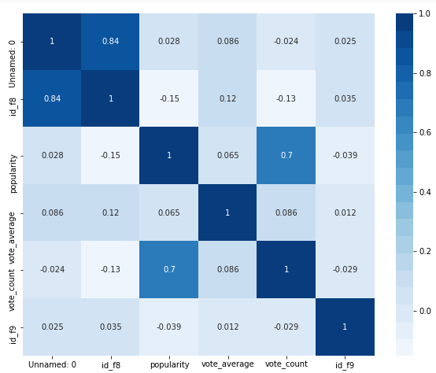
ANALYSING THE CORRELATION OF COLUMNS UNDER REVIEW AND DROPPING UNNECESSARY COLUMNS

Slide 8
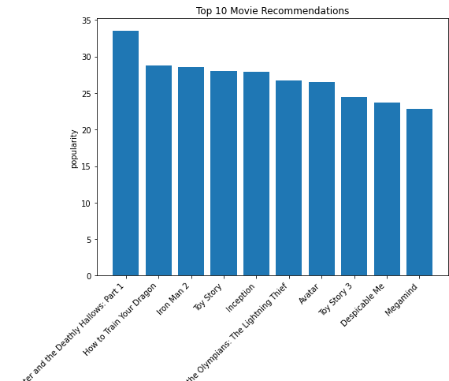
REVIEW OF TOP 10 POPULAR FILMS IN THE INDUSTRY
My proposal is that Microsoft incorporates the template used in the production of these 10 films especially in talent cast and production quality since they were the most sought after in the industry and were quite popular.

Slide 9
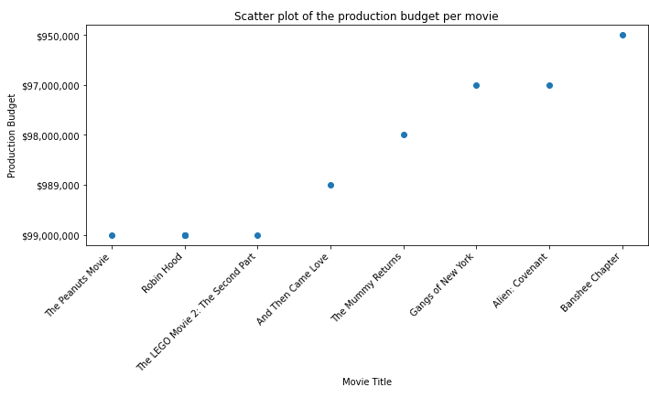
PRODUCTION BUDGET PER FILM

Slide 10
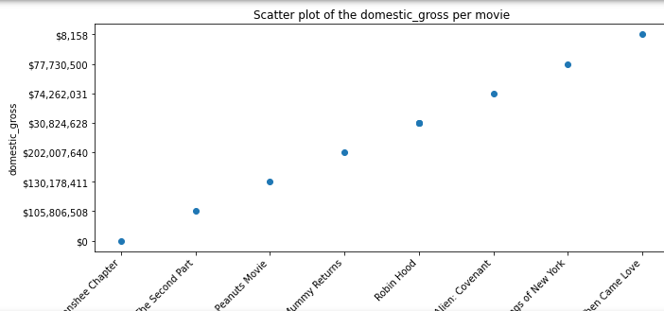
DOMESTIC GROSS PER FILM

Slide 11
PRODUCTION BUDGET VS DOMESTIC GROSS PER FILM
From the above scatter plots which depict the budget per movie produced and income earned domestically, it is quite evident that the higher the budget set, the better the returns.
This is especially due to the product quality in areas of visuals , sound design and cinematography that enhance the viewing experience hence attracting a larger audience.
Marketing and promotion of the films through campaigns and press coverage can drive ticket sales.
However, that is not always the case as in the case of the film Banshee which ended up not selling locally and Robin Hood whose sales income was 1/3 of the production cost hence other factors that may affect sales should be considered eg: Release time, target audience

Slide 12
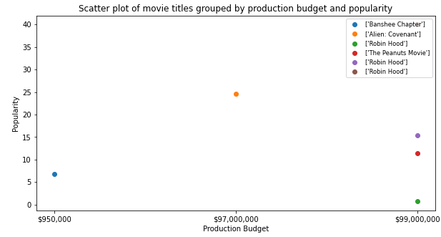
PRODUCTION BUDGET VS POPULARITY OF THE FILMS
From the above scatter plot, there's a clear demonstration of how popularity is a crucial factor in film production as it alludes to the tastes and preferences of the public. A lot was invested in the creation of Robin Hood which was clearly not in demand hence a huge loss was made. On the other hand, public opinion does not necessarily imply a favorable reaction to a movie as in the case of Alien:Covenant whose sales finally led to a loss. This is mostly in movie attendance which is a crude measure of public taste which may not translate to sales. It is therefore crucial that when it comes to production that Microsoft should not rely solely on public opinion since other factors might come into play

Slide 13
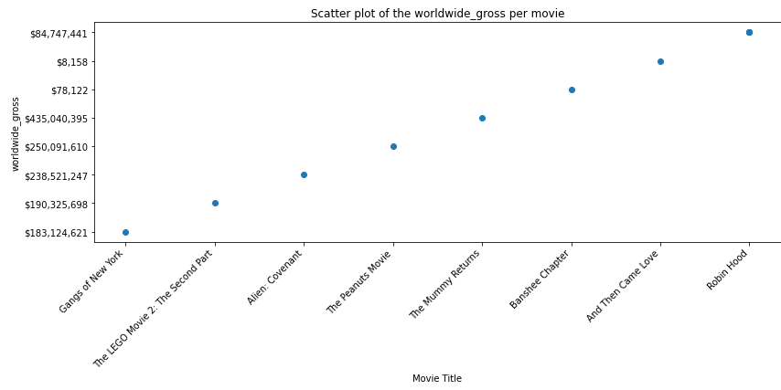
WORLDWIDE GROSS INCOME OF THE TOP 10 FILMS
The above scatter plot has demonstrated how vast consumer preferences are hence the need for Microsoft to consider the international consumers in their production. For instance, Alien:Covenant did so well in the worldwide market and ended up generating more than twice the budget of the production cost in sales. However, it failed terribly in the domestic market. More effort should be made in marketing the films worlwide for wider outreach. Other films such as The Mummy Returns ended up making quadruple the amount invested in the production hence the wider the target audience, the higher the income.

Slide 14
TYPES OF FILMS TO PRODUCE
There is a wide range of films in the industry hence analysis of the same before production is essential to maximize on profits.
This would be crucial in order to cater for different audience preferences.
Some potential types include:
1.Scify – This is due to Microsoft’s cutting edge technology which could explore futuristic themes and advance technologies.
2.Documentaries – This should be based on topics like environmental sustainability or technological advancement.
3. Family friendly content – This could cater to a wide audience demographic

Slide 15
OUTCOME
Movie Titles:
All films that retained their original title when marketing generating more income than the rebrands.
This could be due to factors such as maintenance of artistic integrity that resonates deeply with audiences.
Genres:
My proposal is that Microsoft should incorporate various genres in their film production as the target audience is quite vast which shall increase the gross income.
However the genres in large demand are Action, Adventure or Sci-Fi.
Language:
Microsoft should consider producing a huge chunk of their films in the English language to reach a wider audience while incorporating other languages to serve the minority. This is because English movies have made the most sales when compared to the rest.

